Slide 1
Recording Transactions - Accounting Principles
2022. 3.
Dr. Yangin Yoon

Slide 2
Agenda
Recap the last class
Types of Items
Recording Transactions (Asset, Liability, and Equity)
Recording Transactions (Gain and Loss)
Assignment

Slide 3
Recap the last class
We can make simple examples
- And then, we can decide the calculation rules, based on the examples
Items
- Positive value items
- Negative value items
Income statement
Balance sheet

Slide 4

The Value of Corporations: Simplified Examples
Let’s make our own simple examples!
What is the value of AP Bakery?
- Example #1)
It was established with $5,000 of cash, and AP Bakery Inc. bought new chairs $200. There is no other transactions. And the chairs are not used. (= They can be sold with $200 on the market.)
Value of AP Bakery = $5,000 = $4,800 (Cash) + $200 (Chairs)
- Example #2)
It was established with $5,000 of cash, and AP Bakery lent $300 to Jamie for one year. Jamie will pay back $300 in 2023. There is no other transactions. ( We assume there is no time value of money.) What is the value of AP Bakery during 2022?
Value of AP Bakery = $5,000 = $4,700 (Cash) + $300 (lending money)

Slide 5

Income Statement (Statement of Income)
Income Statement
ST Consulting Company name
Statement of Comprehensive Income
For the Year Ended December 31, 2021 and 2020 Periods
 | 2021 | 2020
Consulting Revenue | $10,000 | $60,000
Salary Expense | $20,000 | $20,000
Electricity Expense | $1,000 | $3,000
Net income | $(11,000) | $37,000

Slide 6

Balance Sheet
Balance Sheet
ST Consulting Company name
Balance Sheet
December 31, 2021 Point in time
 | 2021
ASSETS
Cash | $30,920
Receivable | $1,000
TOTAL ASSETS | $31,920
LIABILITIES AND EQUITY
LIABILITIES
Bank Loan | $9,000
TOTAL LIABILITIES | $9,000
EQUITY
Capital Stock | $20,000
Retained Earnings | $2,920
TOTAL EQUITY | $22,920
TOTAL LIABILITIES and EQUITY | $31,920

Slide 7


Balance Sheet
Balance Sheet
ST Consulting Company name
Balance Sheet
December 31, 2021 Point in time
ASSETS |  |  | LIABILITIES AND EQUITY
 |  |  | LIABILITIES
Cash | $30,920 | $30,920 | Bank Loan | $9,000
Receivable | $1,000 | $1,000 | TOTAL LIABILITIES | $9,000
 |  | $31,920
 |  |  | EQUITY
 |  |  | Capital Stock | $20,000
 |  |  | Retained Earnings | $2,920
 |  |  | TOTAL EQUITY | $22,920
TOTAL ASSETS $31,920 |  |  | TOTAL LIABILITIES and EQUITY $31,920

Slide 8
Any Questions? (Recap)

Slide 9

Types of Items
5 types of items in the income statement and balance sheet
- Asset
- Liability
- Equity
- Gain (or revenue, profit)
- Expense (or cost, loss)

Slide 10


Income Statement
Income Statement
ST Consulting
Statement of Comprehensive Income
For the Year Ended December 31, 2021 and 2020
 | 2021 | 2020
Consulting Revenue | $10,000 | $60,000
Salary Expense | $20,000 | $20,000
Electricity Expense | $1,000 | $3,000
Net income | $(11,000) | $37,000
Revenue
Expense

Slide 11

Balance Sheet
Balance Sheet
ST Consulting
Balance Sheet
December 31, 2021
ASSETS |  |  | LIABILITIES AND EQUITY
 |  |  | LIABILITIES
Cash | $30,920 | $30,920 | Bank Loan | $9,000
Receivable | $1,000 | $1,000 | TOTAL LIABILITIES | $9,000
 |  | $31,920
 |  |  | EQUITY
 |  |  | Capital Stock | $20,000
 |  |  | Retained Earnings | $2,920
 |  |  | TOTAL EQUITY | $22,920
TOTAL ASSETS $31,920 |  |  | TOTAL LIABILITIES and EQUITY $31,920

Slide 12

Format of Accounting Records
Format of Accounting Records
- Asset (Left)
- Liability (Right)
- Equity (Right)
→ Please memorize three places, left and right.
(It is helpful for you to remember the format of the balance sheet.)

Slide 13
Asset Liability
Equity
Let’s make our own simple examples!
Example #1) Starting a business
The AP Bakery was established with $5,000 of cash and there is no other transactions.
In the above example, “Cash” is asset and “Capital stock” is equity.
→ So, Cash is recorded on the left side and Capital Stock is on the right side.
Cash $5,000
Capital Stock $5,000

Slide 14
Asset Liability
Equity
Let’s make our own simple examples!
Example #2) Borrowing a money
It was established with $5,000 of cash, and AP Bakery borrowed $800 from a bank. There is no other transactions. ( We assume there is no time value of money.)
In the above example, “Cash” is asset and “Bank Loan” is liability.
→ So, Cash is recorded on the left side and “Bank Loan” is on the right side.
Cash $5,000
Capital Stock $5,000
Cash $800
Bank Loan $800

Slide 15
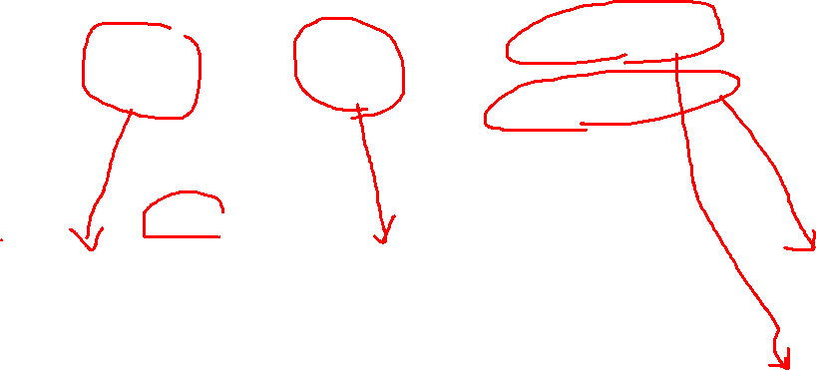
Asset Liability
Equity
Example #2)
It was established with $5,000 of cash, and AP Bakery borrowed $800 from a bank. There is no other transactions. ( We assume there is no time value of money.)
→ Balance Sheet of AP Bakery
Cash $5,000
Capital Stock $5,000
Cash $800
Bank Loan $800
ASSETS |  |  | LIABILITIES AND EQUITY
 |  |  | LIABILITIES
Cash | $5,800 | $30,920 | Bank Loan | $800
 |  | $1,000 | TOTAL LIABILITIES | $800
 |  | $31,920
 |  |  | EQUITY
 |  |  | Capital Stock | $5,000
 |  |  | TOTAL EQUITY | $5,000
TOTAL ASSETS $5,800 |  |  | TOTAL LIABILITIES and EQUITY $5,800

Slide 16

Asset Liability
Equity
Example #2)
It was established with $5,000 of cash, and AP Bakery borrowed $800 from a bank. There is no other transactions. ( We assume there is no time value of money.)
→ Balance Sheet of AP Bakery
Cash $5,000
Capital Stock $5,000
Cash $800
Bank Loan $800
ASSETS |  |  | LIABILITIES AND EQUITY
Cash | $5,800 | $30,920 | Bank Loan | $800
 |  | $1,000
 |  | $31,920
 |  |  | Capital Stock | $5,000

Slide 17

Asset Liability
Equity
Example #2)
It was established with $5,000 of cash, and AP Bakery borrowed $800 from a bank. There is no other transactions. ( We assume there is no time value of money.)
Value of AP Bakery = $5,000 = $5,800 (Cash) - $800 (bank loan)
→ Balance Sheet of AP Bakery
ASSETS |  |  | LIABILITIES AND EQUITY
 |  |  | LIABILITIES
Cash | $5,800 | $30,920 | Bank Loan | $800
 |  | $1,000 | TOTAL LIABILITIES | $800
 |  | $31,920
 |  |  | EQUITY
 |  |  | Capital Stock | $5,000
 |  |  | TOTAL EQUITY | $5,000
TOTAL ASSETS $5,800 |  |  | TOTAL LIABILITIES and EQUITY $5,800

Slide 18
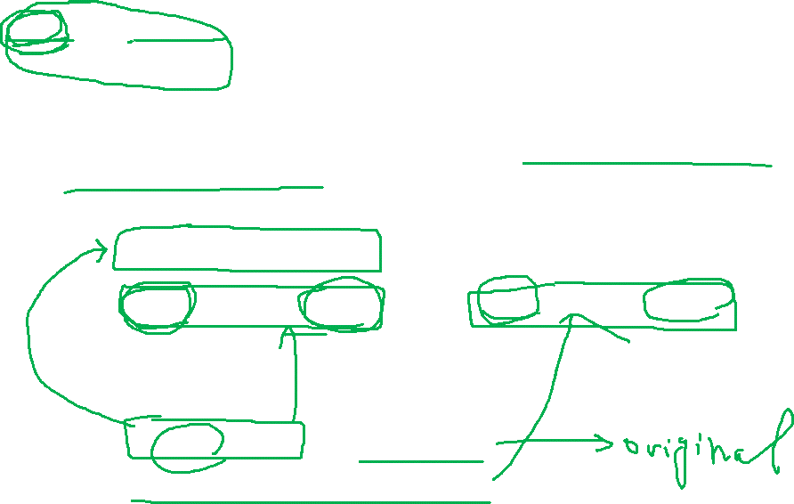
Asset Liability
Equity
Example #3) Buying assets by paying cash
It was established with $5,000 of cash, and AP Bakery bought new chairs by paying $200. There is no other transactions. And the chairs are not used. (= They can be sold with $200 on the market.)
In the above example, “Cash” is asset and “Chair” is also asset.
→ Increasing asset is on the left side.
Decreasing assets is on the right side.
Cash $5,000
Capital Stock $5,000
Chair $200
Cash $200

Slide 19
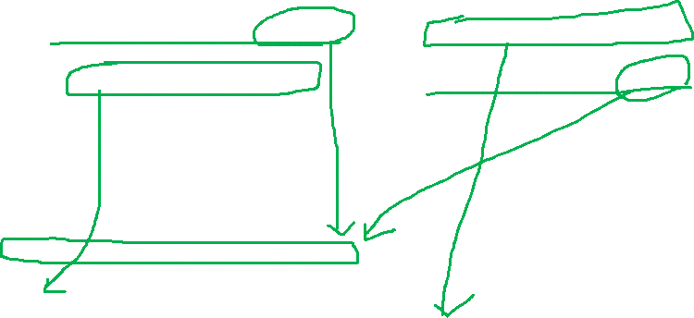
Asset Liability
Equity
Example #3) Buying assets by paying cash
It was established with $5,000 of cash, and AP Bakery bought new chairs by paying $200. There is no other transactions. And the chairs are not used. (= They can be sold with $200 on the market.)
→ Balance Sheet of AP Bakery
Cash $5,000
Capital Stock $5,000
Chair $200
Cash $200
Cash | $4,800 | $30,920
Chair | $200 | $1,000
 |  | $31,920
 |  |  | Capital Stock | $5,000

Slide 20
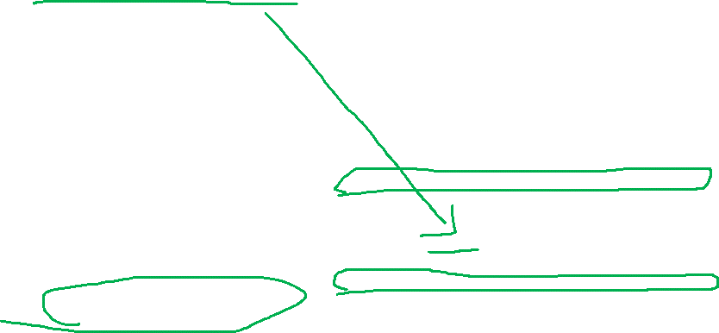
Asset Liability
Equity
Example #3) Buying assets by paying cash
It was established with $5,000 of cash, and AP Bakery bought new chairs by paying $200. There is no other transactions. And the chairs are not used. (= They can be sold with $200 on the market.)
Value of AP Bakery = $5,000 = $4,800 (Cash) + $200 (Chair)
→ Balance Sheet of AP Bakery
ASSETS |  |  | LIABILITIES AND EQUITY
 |  |  | LIABILITIES
Cash | $4,800 | $30,920 | TOTAL LIABILITIES | $0
Chair | $200 | $1,000
 |  | $31,920
 |  |  | EQUITY
 |  |  | Capital Stock | $5,000
 |  |  | TOTAL EQUITY | $5,000
TOTAL ASSETS $5,000 |  |  | TOTAL LIABILITIES and EQUITY $5,000

Slide 21

Asset Liability
Equity
Example #4) Renting a shop with deposit
It was established with $5,000 of cash, and AP Bakery bought new chairs by paying $200.
And AP Bakery rented a shop by giving $1,000 deposit.
In the above example, “Cash” is asset and “Deposit” is also asset.
→ Increasing asset is on the left side.
Decreasing assets is on the right side.
Cash $5,000
Capital Stock $5,000
Chair $200
Cash $200
Deposit $1,000
Cash $1,000

Slide 22

Asset Liability
Equity
Example #4) Renting a shop with deposit
It was established with $5,000 of cash, and AP Bakery bought new chairs by paying $200.
And AP Bakery rented a shop by giving $1,000 deposit.
→ Balance Sheet of AP Bakery
ASSETS |  |  | LIABILITIES AND EQUITY
 |  |  | LIABILITIES
Cash | $3,800 | $30,920 | TOTAL LIABILITIES | $0
Deposit | $1,000 | $1,000
Chair | $200 | $1,000
 |  |  | EQUITY
 |  |  | Capital Stock | $5,000
 |  |  | TOTAL EQUITY | $5,000
TOTAL ASSETS $5,000 |  |  | TOTAL LIABILITIES and EQUITY $5,000

Slide 23

Asset Liability
Equity
Example #5) Lending a money to someone
It was established with $5,000 of cash, and AP Bakery lent $300 to Jamie for one year.
In the above example, “Cash” is asset and “Receivable” is also asset.
→ Increasing asset is on the left side.
Decreasing assets is on the right side.
Cash $5,000
Capital Stock $5,000
Receivable $300
Cash $300

Slide 24
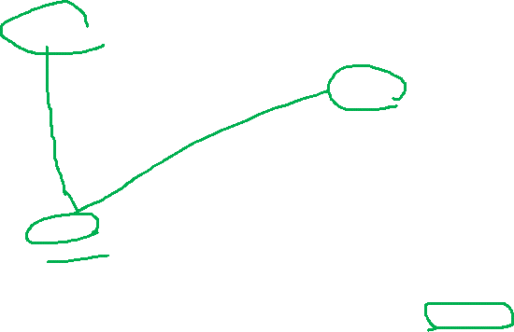
Asset Liability
Equity
Example #5) Lending a money to someone
It was established with $5,000 of cash, and AP Bakery lent $300 to Jamie for one year.
Cash $5,000
Capital Stock $5,000
Receivable $300
Cash $300
ASSETS |  |  | LIABILITIES AND EQUITY
 |  |  | LIABILITIES
Cash | $4,700 | $30,920 | TOTAL LIABILITIES | $0
Receivable | $300 | $1,000
 |  | $1,000
 |  |  | EQUITY
 |  |  | Capital Stock | $5,000
 |  |  | TOTAL EQUITY | $5,000
TOTAL ASSETS $5,000 |  |  | TOTAL LIABILITIES and EQUITY $5,000

Slide 25
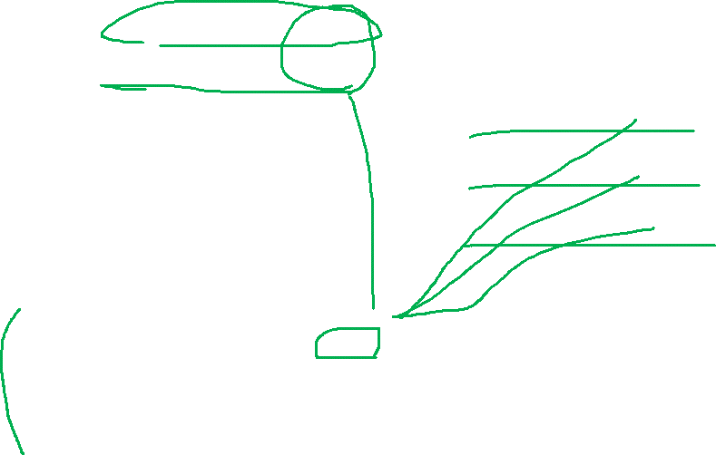
Asset Liability
Equity
Example #6) All the transactions
Cash $5,000
Capital Stock $5,000
Cash $800
Bank Loan $800
Chair $200
Cash $200
Deposit $1,000
Cash $1,000
Receivable $300
Cash $300
Cash | $4,300 | $30,920 | Bank Loan | $800
Receivable | $300 | $1,000
Deposit | $1,000 | $1,000
Chair | $200 | $1,000
 |  | $1,000 | Capital Stock | $5,000

Slide 26
Asset Liability
Equity
Example #6) All the transactions
Cash $5,000
Capital Stock $5,000
Cash $800
Bank Loan $800
Chair $200
Cash $200
Deposit $1,000
Cash $1,000
Receivable $300
Cash $300
ASSETS |  |  | LIABILITIES AND EQUITY
 |  |  | LIABILITIES
Cash | $4,300 | $30,920 | Bank Loan | $800
Receivable | $300 | $1,000 | TOTAL LIABILITIES | $800
Deposit | $1,000 | $1,000
Chair | $200 | $1,000 | EQUITY
 |  | $1,000 | Capital Stock | $5,000
 |  |  | TOTAL EQUITY | $5,000
TOTAL ASSETS $5,800 |  |  | TOTAL LIABILITIES and EQUITY $5,800

Slide 27
Any Questions? (Attendance Check)

Slide 28

Format of Accounting Records (Expense/Loss)
Format of Accounting Records rule #1
- Asset (Left)
- Liability (Right)
- Equity (Right)
How about expense (loss)?
- The expense usually accompanies decrease of assets.
→ Expense is on the left side, because it comes with the cash decrease.
(Cash decrease is on the right side.)
Electricity Expense $200
Cash $200

Slide 29
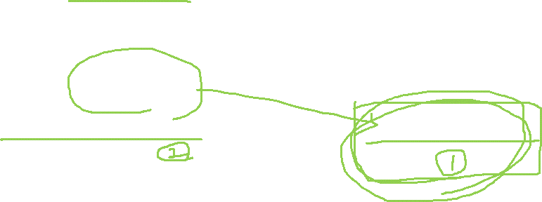
Format of Accounting Records (Revenue/Gain)
Format of Accounting Records rule #1
- Asset (Left)
- Liability (Right)
- Equity (Right)
How about revenue (gain)?
- The expense usually accompanies increase of assets.
→ Revenue is on the right side, because it comes with the cash increase.
(Cash increase is on the left side.)
Cash $200
Revenue $200

Slide 30
Consulting Company Case
Setting
- Jane, Sam, and Tom and studied Data-mining at the same university.
- Three of them decided to open a big data consulting firm.
- They invested their own money:
Jane ($12,000), Sam ($6,000), Tom ($2,000)
- They made a corporation for their consulting business. (The name of the corporation is “ST Consulting”)

Slide 31

Asset Liability
Equity
Example #7) Providing Consulting service
ST Consulting was established with $20,000. There were following events.
 | Mar. 1st~Mar.30th
Consulting Revenue (Cash) | $1,000
Electricity Expense (Cash) | $700
Cash $20,000
Capital Stock $20,000
Cash $1,000
Revenue (gain) $1,000
Electricity Expense $700
Cash $700

Slide 32

Asset Liability
Equity
Example #7) Providing Consulting service
ST Consulting was established with $20,000. There were following events.
→ Balance Sheet?
Cash $20,000
Capital Stock $20,000
Cash $1,000
Revenue (gain) $1,000
Electricity Expense $700
Cash $700
Cash | $20,300 | $30,920
 |  | $1,000
 |  |  | Capital Stock | $20,000
Electricity Expense |  | $700 | Revenue | $1,000

Slide 33
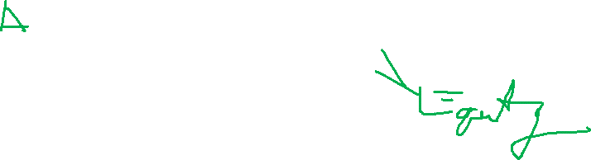
Asset Liability
Equity
Example #7) Providing Consulting service
ST Consulting was established with $20,000. There were following events.
→ Balance Sheet?
Cash $20,000
Capital Stock $20,000
Cash $1,000
Revenue (gain) $1,000
Electricity Expense $700
Cash $700
Cash | $20,300 | $30,920
 |  | $1,000
 |  |  | Capital Stock | $20,000
 |  |  | Earnings | $300

Slide 34
Asset Liability
Equity
Example #7) Providing Consulting service
ST Consulting was established with $20,000. There were following events.
→ Balance Sheet?
Cash $20,000
Capital Stock $20,000
Cash $1,000
Revenue (gain) $1,000
Electricity Expense $700
Cash $700
ASSETS |  |  | LIABILITIES AND EQUITY
 |  |  | LIABILITIES
Cash | $20,300 | $30,920 | TOTAL LIABILITIES | $0
 |  | $1,000 | EQUITY
 |  |  | Capital Stock | $20,000
 |  |  | Earnings | $300
 |  |  | TOTAL EQUITY | $20,300
TOTAL ASSETS $20,300 |  |  | TOTAL LIABILITIES and EQUITY $20,300

Slide 35
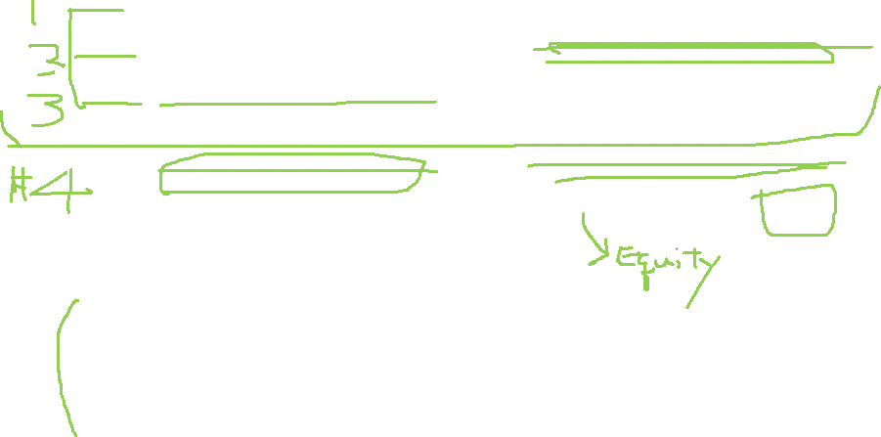
Asset Liability
Equity
Example #7) Providing Consulting service
ST Consulting was established with $20,000. There were following events.
Cash $20,000
Capital Stock $20,000
Cash $1,000
Revenue (gain) $1,000
Electricity Expense $700
Cash $700
Revenue (gain) $1,000
Electricity Expense $700
Earnings $300
Cash | $20,300 | $30,920
 |  | $1,000
 |  |  | Capital Stock | $20,000
 |  |  | Earnings | $300

Slide 36
Asset Liability
Equity
Example #7) Providing Consulting service
ST Consulting was established with $20,000. There were following events.
Cash $20,000
Capital Stock $20,000
Cash $1,000
Revenue (gain) $1,000
Electricity Expense $700
Cash $700
Revenue (gain) $1,000
Electricity Expense $700
Earnings $300
ASSETS |  |  | LIABILITIES AND EQUITY
 |  |  | LIABILITIES
Cash | $20,300 | $30,920 | TOTAL LIABILITIES | $0
 |  | $1,000 | EQUITY
 |  |  | Capital Stock | $20,000
 |  |  | Earnings | $300
 |  |  | TOTAL EQUITY | $20,300
TOTAL ASSETS $20,300 |  |  | TOTAL LIABILITIES and EQUITY $20,300

Slide 37

Asset Liability
Equity
Example #7) Providing Consulting service
ST Consulting was established with $20,000. There were following events.
→ Income Statement?
“Income statement” has only Revenue (Gain) and Expense (loss) items.
Revenue (gain) $1,000
Electricity Expense $700
Earnings $300
 | March
Consulting Revenue | $1,000
Electricity Expense | $700
Net income | $300

Slide 38
Consulting Company Case
Setting
- Jane, Sam, and Tom and studied Data-mining at the same university.
- Three of them decided to open a big data consulting firm.
- They invested their own money:
Jane ($12,000), Sam ($6,000), Tom ($2,000)
- They made a corporation for their consulting business. (The name of the corporation is “ST Consulting”)
- They ran their business from November to December
(multiple periods).

Slide 39

Asset Liability
Equity
Example #8) Providing Consulting service – two-months case
ST Consulting was established with $20,000. There were following events.
ST Consulting was established.
During November
During December
 | Nov. 1st~Nov.30th | Dec. 1st ~ Dec. 31st
Consulting Revenue (Cash) | $1,000 | $5,000
Salary Expense (Cash) | $2,000 | $2,000
Cash $20,000
Capital Stock $20,000
Cash $1,000
Revenue (gain) $1,000
Salary Expense $2,000
Cash $2,000
Cash $5,000
Revenue (gain) $5,000
Salary Expense $2,000
Cash $2,000

Slide 40
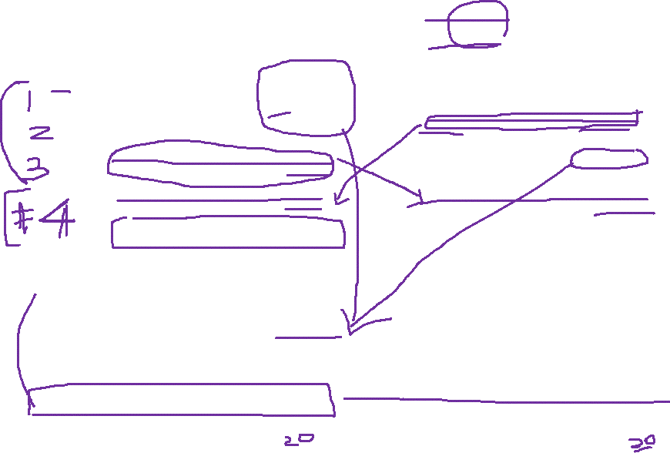
Example #8) Providing Consulting service – two-months case
ST Consulting was established with $5,000. There were following events.
At the end of November
Balance Sheet (on November 30th)
 | Nov. 1st~Nov.30th | Dec. 1st ~ Dec. 31st
Consulting Revenue (Cash) | $1,000 | $5,000
Salary Expense (Cash) | $2,000 | $2,000
Cash $20,000
Capital Stock $20,000
Cash $1,000
Revenue (gain) $1,000
Salary Expense $2,000
Cash $2,000
Revenue (gain) $1,000
Salary Expense $2,000
Earnings (loss) $1,000
Cash | $19,000 | $30,920
 |  | $30,920
 |  | $1,000
 |  |  | Capital Stock | $20,000
Earnings |  | $1,000

Slide 41
Example #8) Providing Consulting service – two-months case
ST Consulting was established with $5,000. There were following events.
At the end of November
Balance Sheet (on November 30th)
 | Nov. 1st~Nov.30th | Dec. 1st ~ Dec. 31st
Consulting Revenue (Cash) | $1,000 | $5,000
Salary Expense (Cash) | $2,000 | $2,000
Cash $20,000
Capital Stock $20,000
Cash $1,000
Revenue (gain) $1,000
Salary Expense $2,000
Cash $2,000
Revenue (gain) $1,000
Salary Expense $2,000
Earnings (loss) $1,000
Cash | $19,000 | $30,920
 |  | $30,920
 |  | $1,000
 |  |  | Capital Stock | $20,000
 |  |  | Earnings | ($1,000)

Slide 42

Example #8) Providing Consulting service – two-months case
ST Consulting was established with $5,000. There were following events.
At the end of November
Balance Sheet (on November 30th)
 | Nov. 1st~Nov.30th | Dec. 1st ~ Dec. 31st
Consulting Revenue (Cash) | $1,000 | $5,000
Salary Expense (Cash) | $2,000 | $2,000
Cash $20,000
Capital Stock $20,000
Cash $1,000
Revenue (gain) $1,000
Salary Expense $2,000
Cash $2,000
Revenue (gain) $1,000
Salary Expense $2,000
Earnings (loss) $1,000
ASSETS |  |  | LIABILITIES AND EQUITY
Cash | $19,000 | $30,920 | LIABILITIES
 |  | $30,920 | TOTAL LIABILITIES | $0
 |  | $1,000 | EQUITY
 |  |  | Capital Stock | $20,000
 |  |  | Earnings | ($1,000)
 |  |  | TOTAL EQUITY | $19,000
TOTAL ASSETS $19,000 |  |  | TOTAL LIABILITIES and EQUITY $19,000

Slide 43
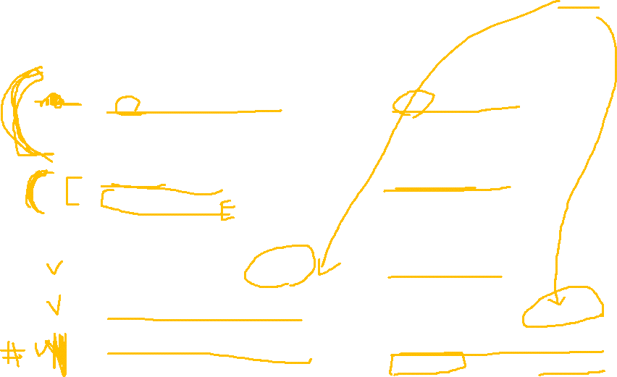
Example #8) Providing Consulting service – two-months case
ST Consulting was established with $5,000. There were following events.
At the end of November
At the End of December
 | Nov. 1st~Nov.30th | Dec. 1st ~ Dec. 31st
Consulting Revenue (Cash) | $1,000 | $5,000
Salary Expense (Cash) | $2,000 | $2,000
Cash $20,000
Capital Stock $20,000
Cash $1,000
Revenue (gain) $1,000
Salary Expense $2,000
Cash $2,000
Revenue (gain) $1,000
Salary Expense $2,000
Earnings (loss) $1,000
Cash $5,000
Revenue (gain) $5,000
Salary Expense $2,000
Cash $2,000
Revenue (gain) $5,000
Salary Expense $2,000
Earnings $3,000

Slide 44

Example #8) Providing Consulting service – two-months case
At the End of December
Re-arrange the above
Cash $20,000
Capital Stock $20,000
Cash $1,000
Revenue (gain) $1,000
Salary Expense $2,000
Cash $2,000
Revenue (gain) $1,000
Salary Expense $2,000
Earnings (loss) $1,000
Cash $5,000
Revenue (gain) $5,000
Salary Expense $2,000
Cash $2,000
Revenue (gain) $5,000
Salary Expense $2,000
Earnings $3,000
Cash $22,000
Capital Stock $20,000
Earnings $2,000

Slide 45

Example #8) Providing Consulting service – two-months case
Re-arrange the above (Or accumulated accounting records)
Balance Sheet (on December 30th)
Cash $22,000
Capital Stock $20,000
Earnings $2,000
ASSETS |  |  | LIABILITIES AND EQUITY
Cash | $22,000 | $30,920 | LIABILITIES
 |  | $30,920 | TOTAL LIABILITIES | $0
 |  | $1,000 | EQUITY
 |  |  | Capital Stock | $20,000
 |  |  | Earnings | $2,000
 |  |  | TOTAL EQUITY | $22,000
TOTAL ASSETS $22,000 |  |  | TOTAL LIABILITIES and EQUITY $22,000

Slide 46
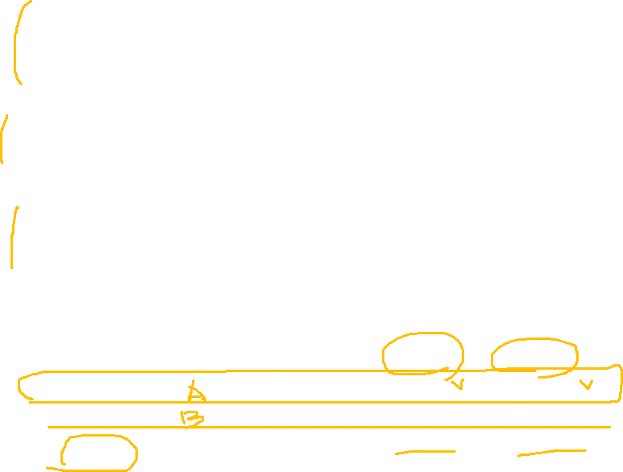
Example #8) Providing Consulting service – two-months case
- November
- December
Income Statement
 | Nov. 1st~Nov.30th | Dec. 1st ~ Dec. 31st
Consulting Revenue (Cash) | $1,000 | $5,000
Salary Expense (Cash) | $2,000 | $2,000
Revenue (gain) $1,000
Salary Expense $2,000
Earnings (loss) $1,000
Revenue (gain) $5,000
Salary Expense $2,000
Earnings $3,000
 | November | December
Consulting Revenue | $1,000 | $5,000
Electricity Expense | $2,000 | $2,000
Net income (loss) | $(1,000) | $3,000

Slide 47

Example #8) Providing Consulting service – two-months case
<Balance Sheet>
ST Consulting
Balance Sheet
November 30, 2021 and December 31, 2021
Nov. Dec. Nov. Dec.
ASSETS |  |  | LIABILITIES AND EQUITY
Cash $19,000 | $22,000 | $30,920 | LIABILITIES
 |  | $30,920 | TOTAL LIABILITIES 0$ | $0
 |  | $1,000 | EQUITY
 |  |  | Capital Stock $20,000 | $20,000
 |  |  | Earnings ($1,000) | $2,000
 |  |  | TOTAL EQUITY $19,000 | $22,000
TOTAL ASSETS $19,000 $22,000 |  |  | TOTAL LIABILITIES and EQUITY $19,000 $22,000

Slide 48
Any Questions?

Slide 49
Consulting Company Case #3
Setting
- Jane, Sam, and Tom and studied Data-mining at the same university.
- Three of them decided to open a big data consulting firm.
- They invested their own money:
Jane ($12,000), Sam ($6,000), Tom ($2,000)
- They made a corporation for their consulting business. (The name of the corporation is “ST Consulting”)
- For now, they hired Sally and Nancy. (Only Sally and Nancy are the employees of the company.)
- ST Consulting borrowed $9,000 from a bank for ten years.

Slide 50

Asset Liability
Equity
Example #9) Providing Consulting service – on-credit revenue
ST Consulting was established with $20,000, and $9,000 bank loan. There were following events.
ST Consulting was established.
During November
 | Nov. 1st~Nov.30th | Dec. 1st ~ Dec. 31st | Jan. 1st ~ Jan. 31st
Consulting Revenue (Cash) | $1,000 | $5,000 | $6,000
Consulting Revenue (on credit, pay later) | $0 | $1,000 | $2,000
Salary Expense (Cash) | $2,000 | $2,000 | $2,000
Interest Expense (Cash) | $40 | $40 | $40

Slide 51

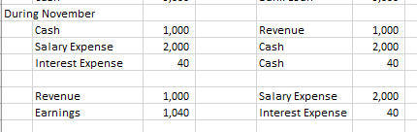
Asset Liability
Equity
Example #9) Providing Consulting service – on-credit revenue
ST Consulting was established with $20,000, and $9,000 bank loan. There were following events.
ST Consulting was established.
During November
 | Nov. 1st~Nov.30th | Dec. 1st ~ Dec. 31st | Jan. 1st ~ Jan. 31st
Consulting Revenue (Cash) | $1,000 | $5,000 | $6,000
Consulting Revenue (on credit, pay later) | $0 | $1,000 | $2,000
Salary Expense (Cash) | $2,000 | $2,000 | $2,000
Interest Expense (Cash) | $40 | $40 | $40

Slide 52
Asset Liability
Equity
Example #9) Providing Consulting service – on-credit revenue
ST Consulting was established with $20,000, and $9,000 bank loan. There were following events.
Summary of earnings
At the end of November
Balance Sheet on Nov. 30th
 | Nov. 1st~Nov.30th | Dec. 1st ~ Dec. 31st | Jan. 1st ~ Jan. 31st
Consulting Revenue (Cash) | $1,000 | $5,000 | $6,000
Consulting Revenue (on credit, pay later) | $0 | $1,000 | $2,000
Salary Expense (Cash) | $2,000 | $2,000 | $2,000
Interest Expense (Cash) | $40 | $40 | $40

Slide 53

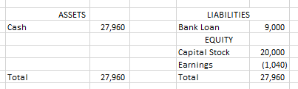
Asset Liability
Equity
Example #9) Providing Consulting service – on-credit revenue
ST Consulting was established with $20,000, and $9,000 bank loan. There were following events.
Summary of earnings
At the end of November
Balance Sheet on Nov. 30th
 | Nov. 1st~Nov.30th | Dec. 1st ~ Dec. 31st | Jan. 1st ~ Jan. 31st
Consulting Revenue (Cash) | $1,000 | $5,000 | $6,000
Consulting Revenue (on credit, pay later) | $0 | $1,000 | $2,000
Salary Expense (Cash) | $2,000 | $2,000 | $2,000
Interest Expense (Cash) | $40 | $40 | $40

Slide 54

Asset Liability
Equity
Example #9) Providing Consulting service – on-credit revenue
ST Consulting was established with $20,000, and $9,000 bank loan. There were following events.
During December
 | Nov. 1st~Nov.30th | Dec. 1st ~ Dec. 31st | Jan. 1st ~ Jan. 31st
Consulting Revenue (Cash) | $1,000 | $5,000 | $6,000
Consulting Revenue (on credit, pay later) | $0 | $1,000 | $2,000
Salary Expense (Cash) | $2,000 | $2,000 | $2,000
Interest Expense (Cash) | $40 | $40 | $40

Slide 55

Asset Liability
Equity
Example #9) Providing Consulting service – on-credit revenue
ST Consulting was established with $20,000, and $9,000 bank loan. There were following events.
During December
 | Nov. 1st~Nov.30th | Dec. 1st ~ Dec. 31st | Jan. 1st ~ Jan. 31st
Consulting Revenue (Cash) | $1,000 | $5,000 | $6,000
Consulting Revenue (on credit, pay later) | $0 | $1,000 | $2,000
Salary Expense (Cash) | $2,000 | $2,000 | $2,000
Interest Expense (Cash) | $40 | $40 | $40

Slide 56
Asset Liability
Equity
Example #9) Providing Consulting service – on-credit revenue
ST Consulting was established with $20,000, and $9,000 bank loan. There were following events.
Summary of earnings
At the end of December
Balance Sheet on Dec. 31st
 | Nov. 1st~Nov.30th | Dec. 1st ~ Dec. 31st | Jan. 1st ~ Jan. 31st
Consulting Revenue (Cash) | $1,000 | $5,000 | $6,000
Consulting Revenue (on credit, pay later) | $0 | $1,000 | $2,000
Salary Expense (Cash) | $2,000 | $2,000 | $2,000
Interest Expense (Cash) | $40 | $40 | $40

Slide 57


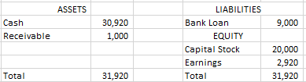
Asset Liability
Equity
Example #9) Providing Consulting service – on-credit revenue
ST Consulting was established with $20,000, and $9,000 bank loan. There were following events.
Summary of earnings
At the end of December
Balance Sheet on Dec. 31st
 | Nov. 1st~Nov.30th | Dec. 1st ~ Dec. 31st | Jan. 1st ~ Jan. 31st
Consulting Revenue (Cash) | $1,000 | $5,000 | $6,000
Consulting Revenue (on credit, pay later) | $0 | $1,000 | $2,000
Salary Expense (Cash) | $2,000 | $2,000 | $2,000
Interest Expense (Cash) | $40 | $40 | $40

Slide 58
Asset Liability
Equity
Example #9) Providing Consulting service – on-credit revenue
ST Consulting was established with $20,000, and $9,000 bank loan. There were following events.
During January
 | Nov. 1st~Nov.30th | Dec. 1st ~ Dec. 31st | Jan. 1st ~ Jan. 31st
Consulting Revenue (Cash) | $1,000 | $5,000 | $6,000
Consulting Revenue (on credit, pay later) | $0 | $1,000 | $2,000
Salary Expense (Cash) | $2,000 | $2,000 | $2,000
Interest Expense (Cash) | $40 | $40 | $40

Slide 59


Asset Liability
Equity
Example #9) Providing Consulting service – on-credit revenue
ST Consulting was established with $20,000, and $9,000 bank loan. There were following events.
During January
 | Nov. 1st~Nov.30th | Dec. 1st ~ Dec. 31st | Jan. 1st ~ Jan. 31st
Consulting Revenue (Cash) | $1,000 | $5,000 | $6,000
Consulting Revenue (on credit, pay later) | $0 | $1,000 | $2,000
Salary Expense (Cash) | $2,000 | $2,000 | $2,000
Interest Expense (Cash) | $40 | $40 | $40

Slide 60
Asset Liability
Equity
Example #9) Providing Consulting service – on-credit revenue
ST Consulting was established with $20,000, and $9,000 bank loan. There were following events.
Summary of earnings
At the end of January
Balance Sheet on Jan. 31st.
 | Nov. 1st~Nov.30th | Dec. 1st ~ Dec. 31st | Jan. 1st ~ Jan. 31st
Consulting Revenue (Cash) | $1,000 | $5,000 | $6,000
Consulting Revenue (on credit, pay later) | $0 | $1,000 | $2,000
Salary Expense (Cash) | $2,000 | $2,000 | $2,000
Interest Expense (Cash) | $40 | $40 | $40

Slide 61


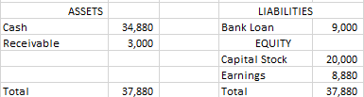


Asset Liability
Equity
Example #9) Providing Consulting service – on-credit revenue
ST Consulting was established with $20,000, and $9,000 bank loan. There were following events.
Summary of earnings
At the end of January
Balance Sheet on Jan. 31st.
 | Nov. 1st~Nov.30th | Dec. 1st ~ Dec. 31st | Jan. 1st ~ Jan. 31st
Consulting Revenue (Cash) | $1,000 | $5,000 | $6,000
Consulting Revenue (on credit, pay later) | $0 | $1,000 | $2,000
Salary Expense (Cash) | $2,000 | $2,000 | $2,000
Interest Expense (Cash) | $40 | $40 | $40

Slide 62
Asset Liability
Equity
Example #9) Providing Consulting service – on-credit revenue
ST Consulting was established with $20,000, and $9,000 bank loan. There were following events.
Balance Sheet at the end of three months
 | Nov. 1st~Nov.30th | Dec. 1st ~ Dec. 31st | Jan. 1st ~ Jan. 31st
Consulting Revenue (Cash) | $1,000 | $5,000 | $6,000
Consulting Revenue (on credit, pay later) | $0 | $1,000 | $2,000
Salary Expense (Cash) | $2,000 | $2,000 | $2,000
Interest Expense (Cash) | $40 | $40 | $40

Slide 63
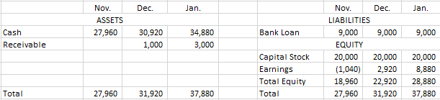
Asset Liability
Equity
Example #9) Providing Consulting service – on-credit revenue
ST Consulting was established with $20,000, and $9,000 bank loan. There were following events.
Balance Sheet at the end of three months
 | Nov. 1st~Nov.30th | Dec. 1st ~ Dec. 31st | Jan. 1st ~ Jan. 31st
Consulting Revenue (Cash) | $1,000 | $5,000 | $6,000
Consulting Revenue (on credit, pay later) | $0 | $1,000 | $2,000
Salary Expense (Cash) | $2,000 | $2,000 | $2,000
Interest Expense (Cash) | $40 | $40 | $40

Slide 64
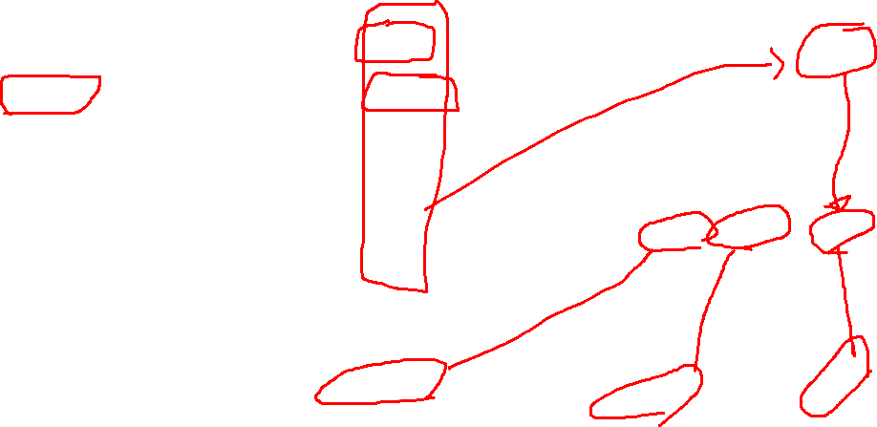
ST Consulting Case #3
ST Consulting started its business on 1st of November.
What were the profits of each month? (On-credit revenue will be paid one year later. At this moment, the customers are rich. They will pay the bill one year later.)
How much cash did ST Consulting have at the end of each month?
What were the value of ST Consulting at the end of each month?
(We are mainly looking at the past transactions, not the future events.)
 | Nov. 1st~Nov.30th | Dec. 1st ~ Dec. 31st | Jan. 1st ~ Jan. 31st
Consulting Revenue (Cash) | $1,000 | $5,000 | $6,000
Consulting Revenue (on credit, pay later) | $0 | $1,000 | $2,000
Salary Expense (Cash) | $2,000 | $2,000 | $2,000
Interest Expense (Cash) | $40 | $40 | $40

Slide 65

Asset Liability
Equity
More examples)
The company buys land by paying $10,000 of cash.
The company borrows money ($5,000) from a bank.
The company pays interest expense by paying $150 of cash.
The company repays the whole bank loan.
Land $10,000
Cash $10,000
Cash $5,000
Bank Loan $5,000
Interest Expense $150
Cash $150
Bank Loan $5,000
Cash $5,000

Slide 66

Homework #1
The homework will be posted on E-class
Due date is March 21, 09:59 AM
Example
Let’s assume that you are the head of accounting department of ABC Inc. The following are transactions of ABC Inc. Please make general entries on each transaction.
(Tr#1)
ABC Inc. issued stocks. The capital stock was increased by $1,000. The company received $1,000 of cash for this.

Slide 67
Any Questions?

